Slide 1
2021 World Kidney Day Activity Report

Slide 2
TKF – 2021 World Kidney Day
Living Well With Kidney Disease
Regarding recent CKD situation and pandemic measures in Turkey, Turkish Kidney Foundation has decided to adopt the 2021’s motto as «The Decision Is Yours» by considering TKF’s mission statement.
The Decision Is Yours has referred to Turkish Kidney Foundation’s «Kidney Health and Nutrition» nationwide field project since 2011.

Slide 3
TKF – 2021 World Kidney Day – KEY VISUAL
Visual Description:
Two kidneys symbolize two different life styles.
Kidney on the right stands for healthy nutrition and healthy life sytle, therefore it is bright and colorful.
Kidney on the left is for unhealthy choices, junk food, lack of exercise, etc. This is shown with dull colors and dim light.
At the end, we reach to a crossroad and one’s choice to continue his/her life will define the quality of life for the rest of the life.

Slide 4
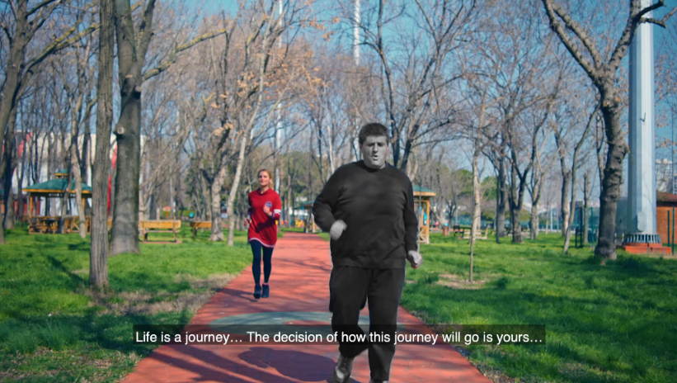
TKF – 2021 World Kidney Day - VIDEO
Video:
Based on the scenario of WKD key visual is designed, a 59-second video was produced to show on digital media.

Slide 5
TKF – 2021 World Kidney Day
Living Well With Kidney Disease
The Decision Is Yours
2021 Campaign also refers to previous WKD campaigns of Turkish Kidney Foundation:
2020 – 8 Golden Rules (Essentials of healthy habits)
2019 – Obese Market (Thought balloons)
2018 – Women Touch on Kidney Health (Healthy woman figurine)
2012 – You Have Only Two Rights (Crossroads)

Slide 6
TKF – 2021 World Kidney Day
Living Well With Kidney Disease
The Decision Is Yours
MEDIA CHANNELS:
Due to Covid-19 pandemic, outdoor activities could not be organized.
Key visual design is used for conventional media, digital media and social media.
Various press outcomes both written and visual media such as national/local newspapers, online news sites and national/local TV channels.

Slide 7
TKF – 2021 World Kidney Day
İstanbul Metropolitan Municipality (İBB):
50 CLP (vertical visual areas)
Modyo TV (City’s main public transpaortation network)
İBB TV (İBB’s closed circuit TV channel)
İBB Outdoor screens
İBB LED screens
No photos available yet

Slide 8
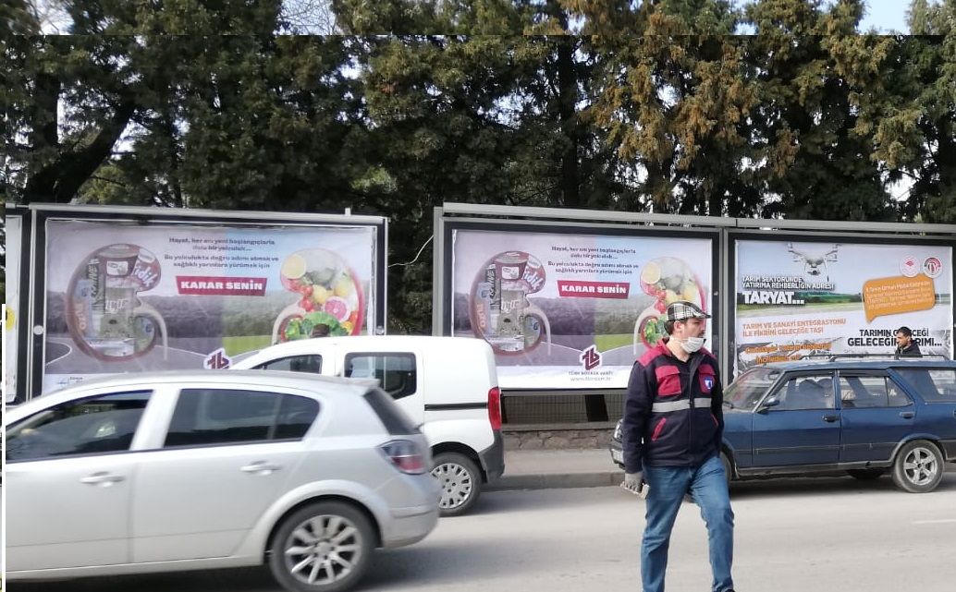
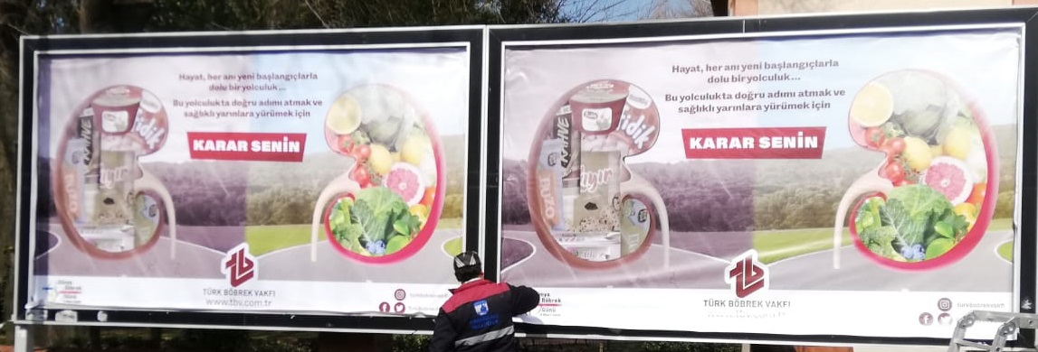
TKF – 2021 World Kidney Day
City of Canakkale Municipality
10 CLP’s (Vertical visual area)
4 Billboards

Slide 9
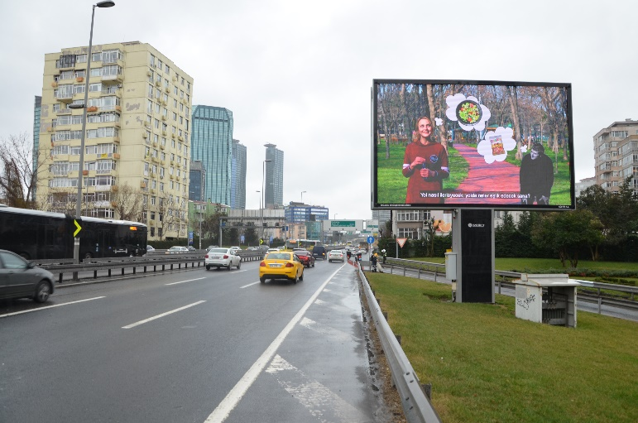
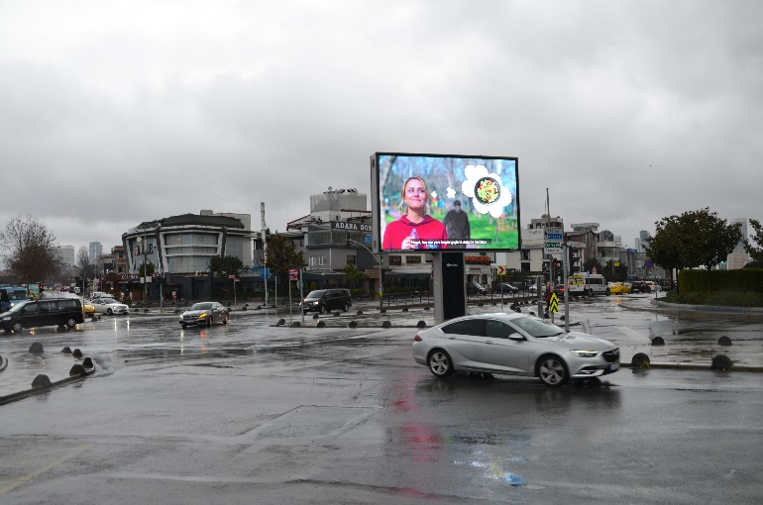
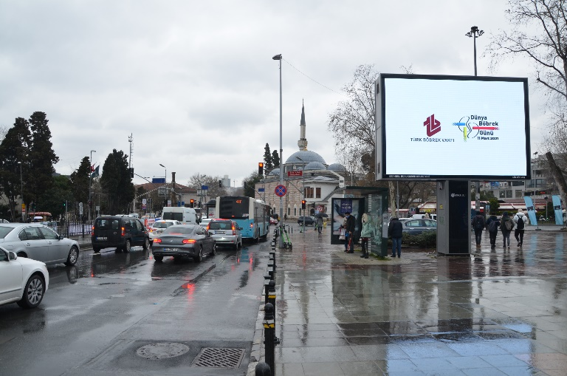
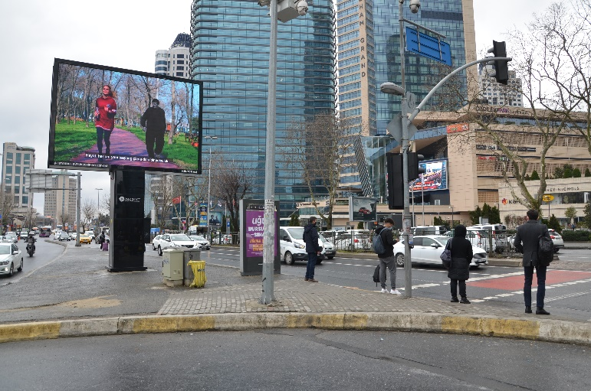
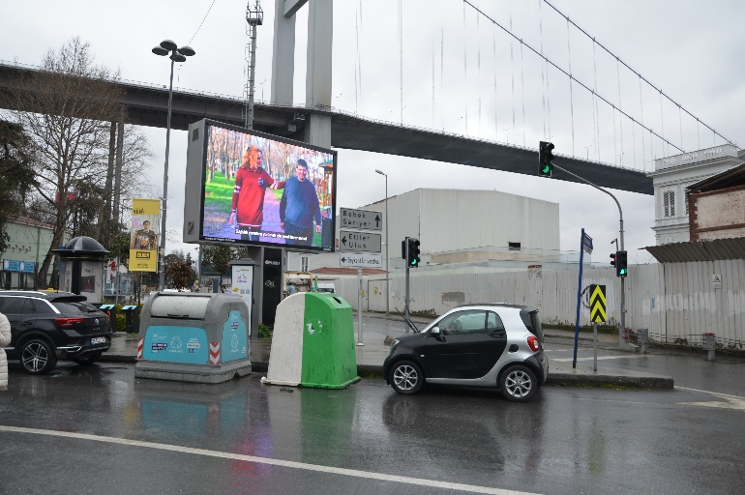
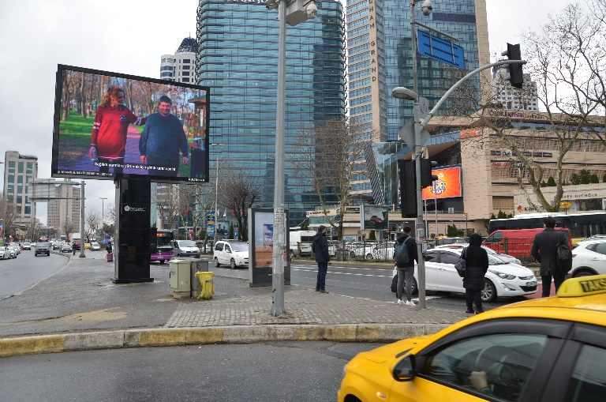
TKF – 2021 World Kidney Day
Panoffect – ON TV: 23 giant TV screens on highways, main arteries and city squares of Istanbul. Broadcasting frequency: 250 times/day

Slide 10
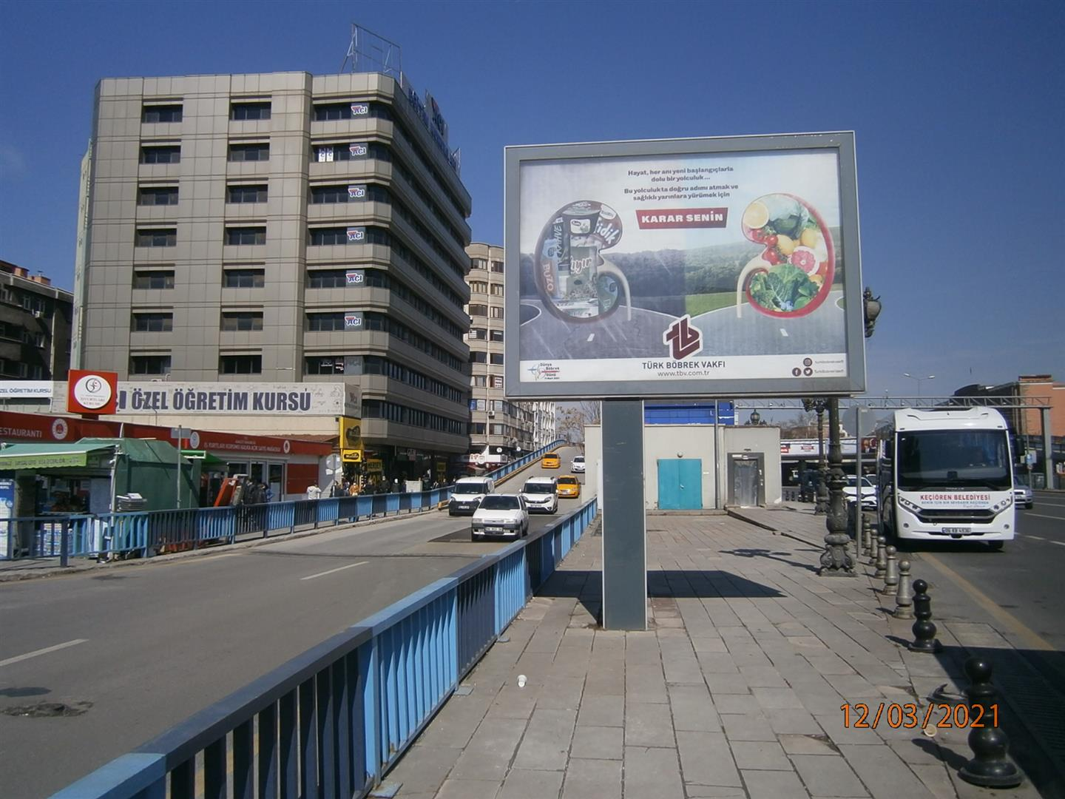
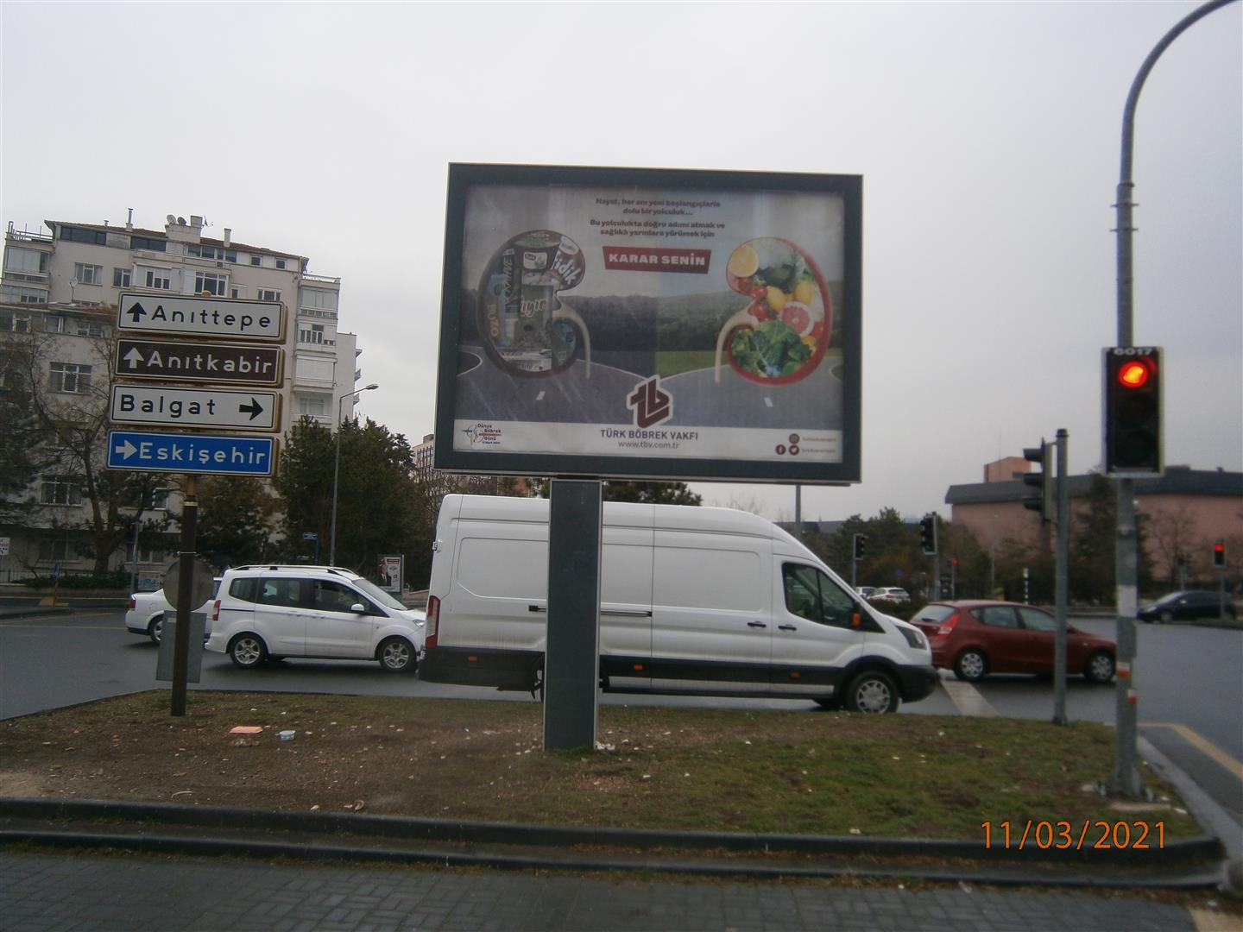
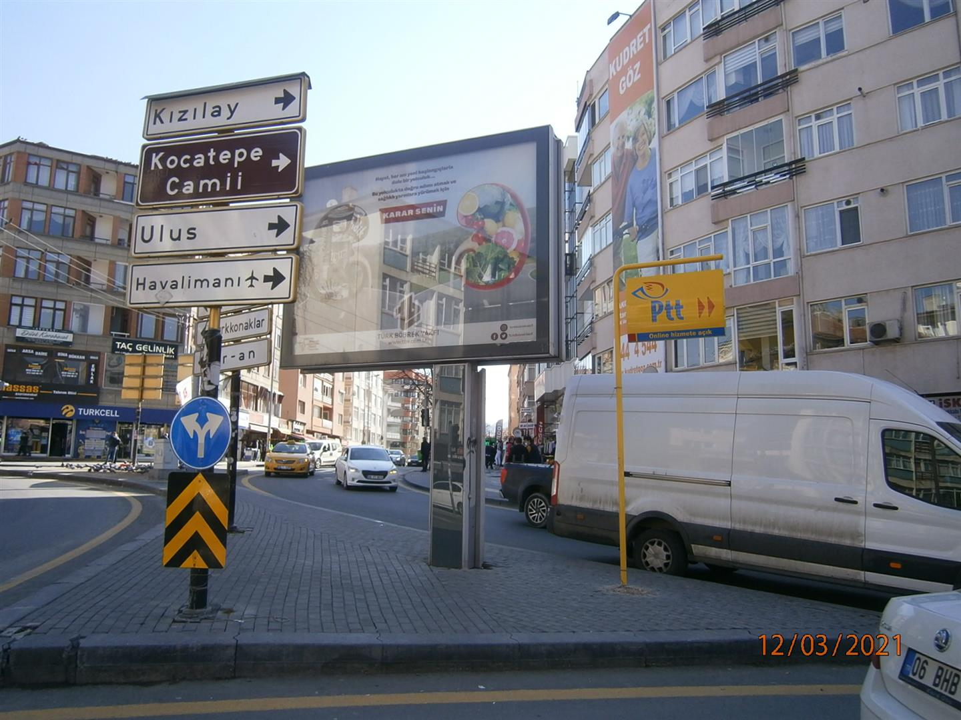
TKF – 2021 World Kidney Day
Kentvizyon-Ankara Megaligths: 15 totem poles of 8,75 m² in nation’s capitol Ankara’s main arteries and city squares

Slide 11
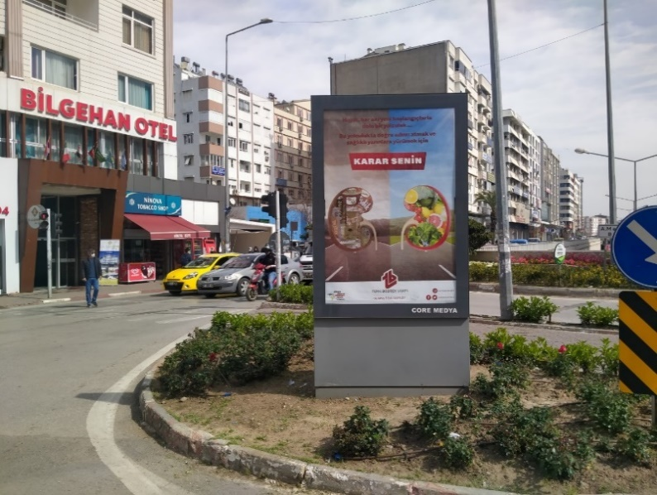
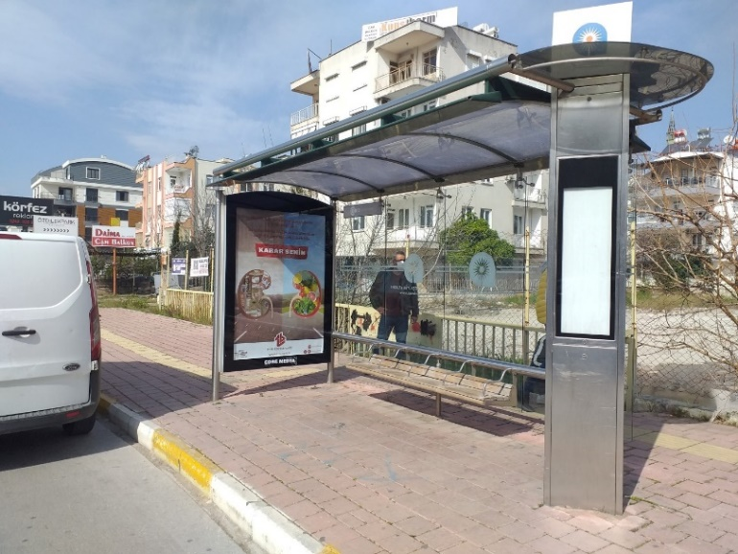
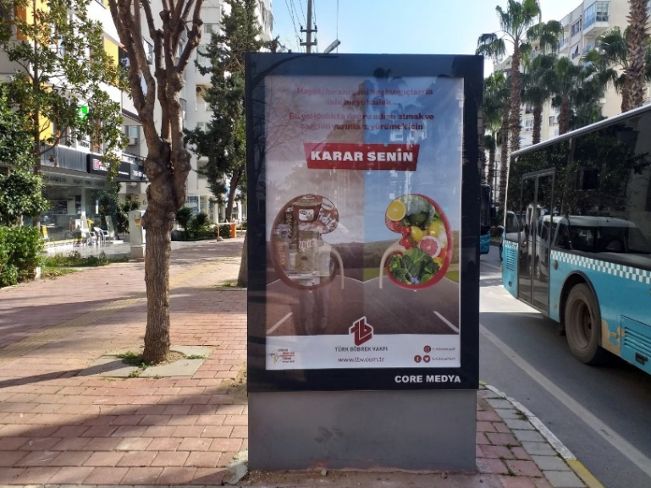
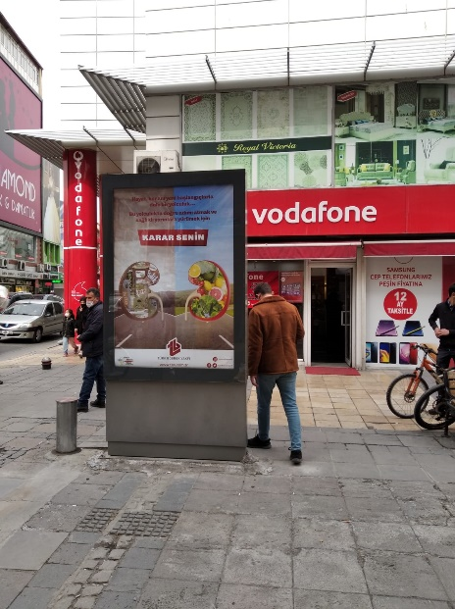
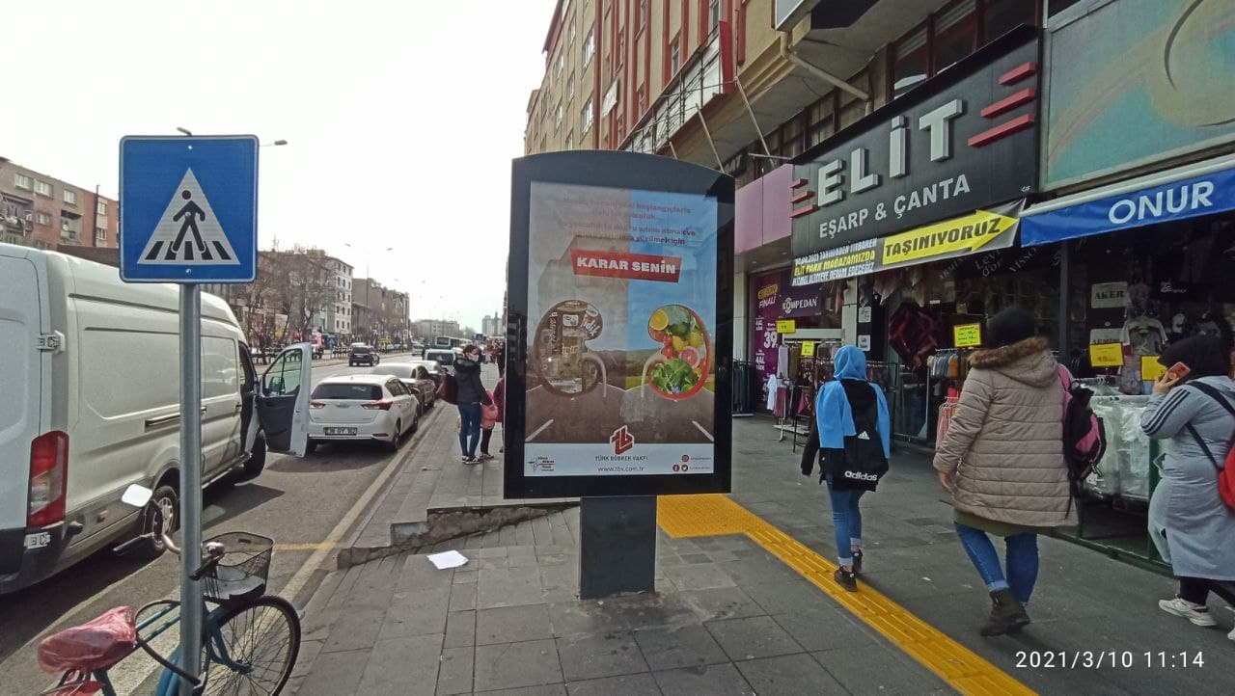
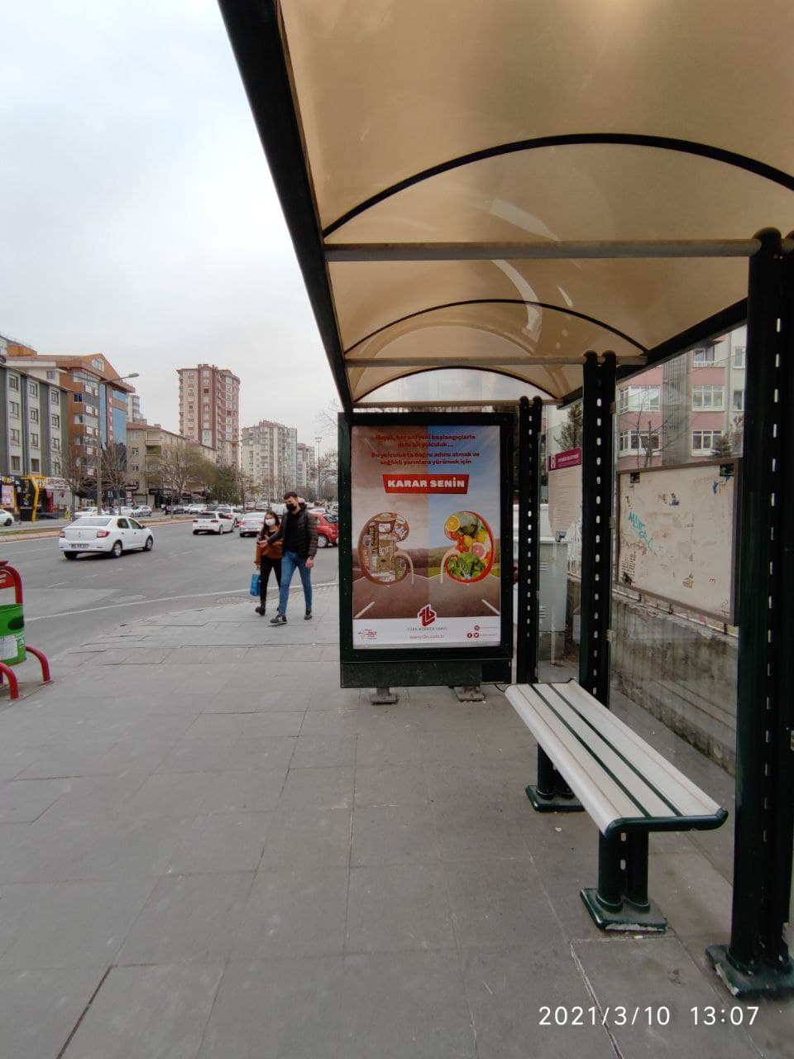
TKF – 2021 World Kidney Day
Coreooh: 50 CLP’s in the city of Antalya (Mediterannean Region) and 50 CLP’s in the city of Kayseri (Middle Anatolia Region)

Slide 12
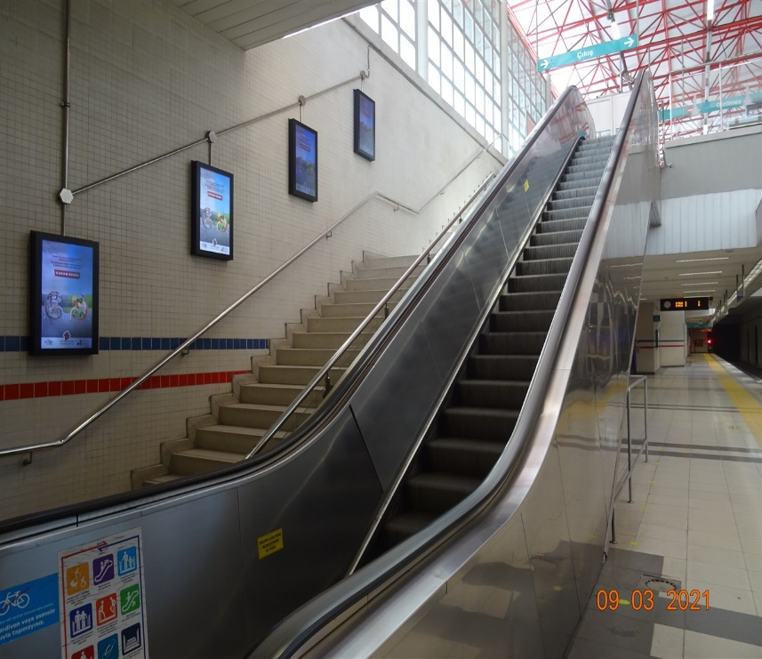
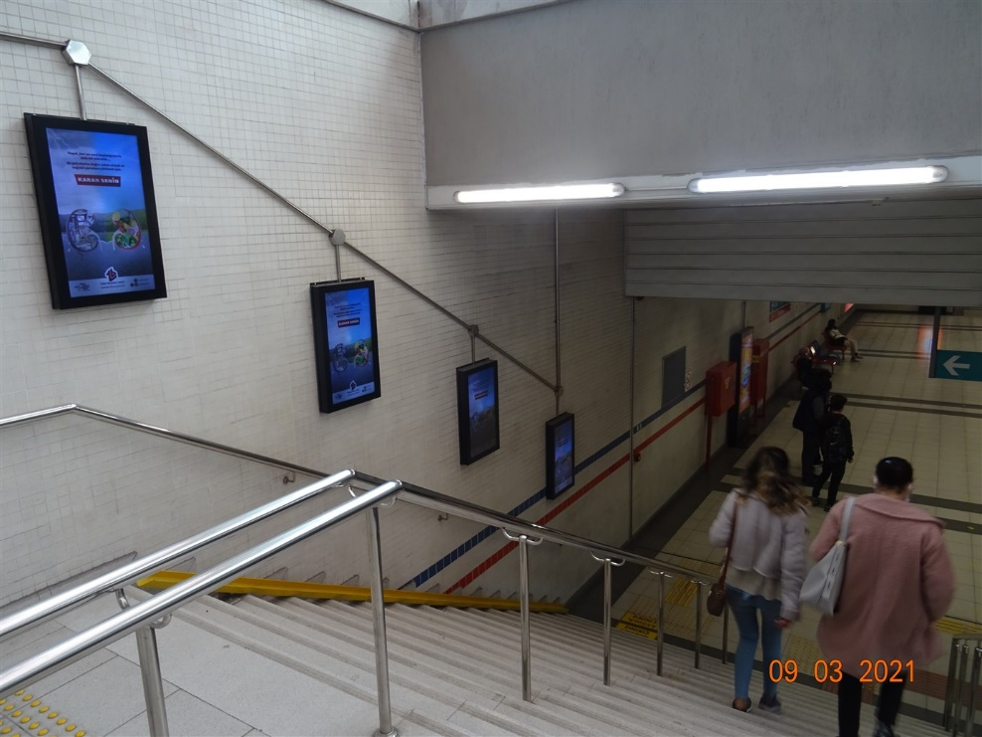
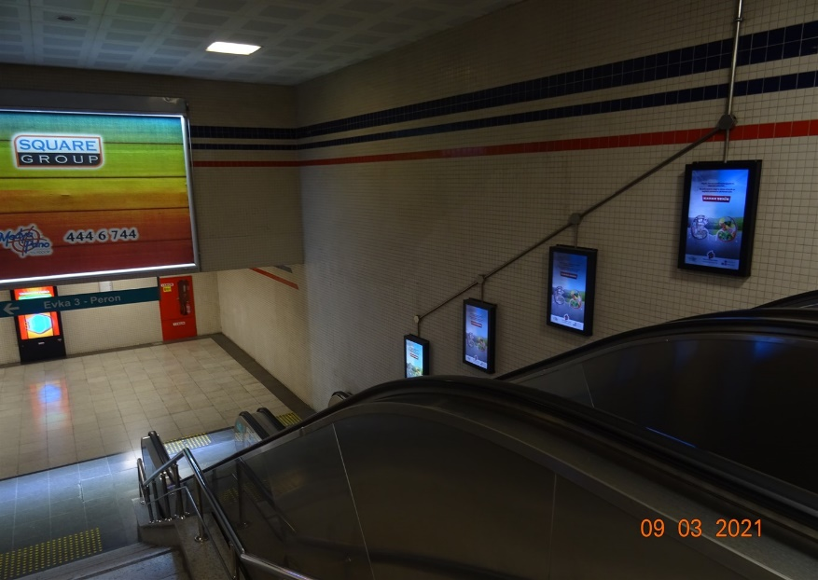
TKF – 2021 World Kidney Day
Medyapano:
İzmir subway line, 8 stations, 250 poster areas

Slide 13
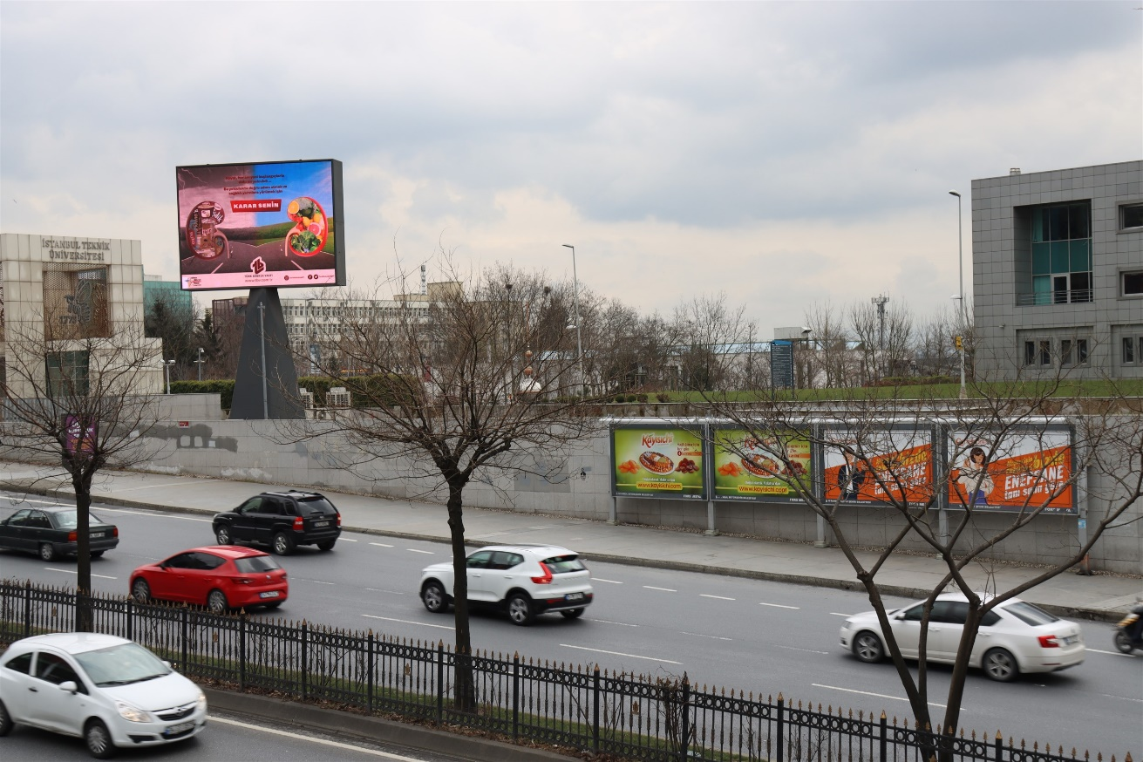
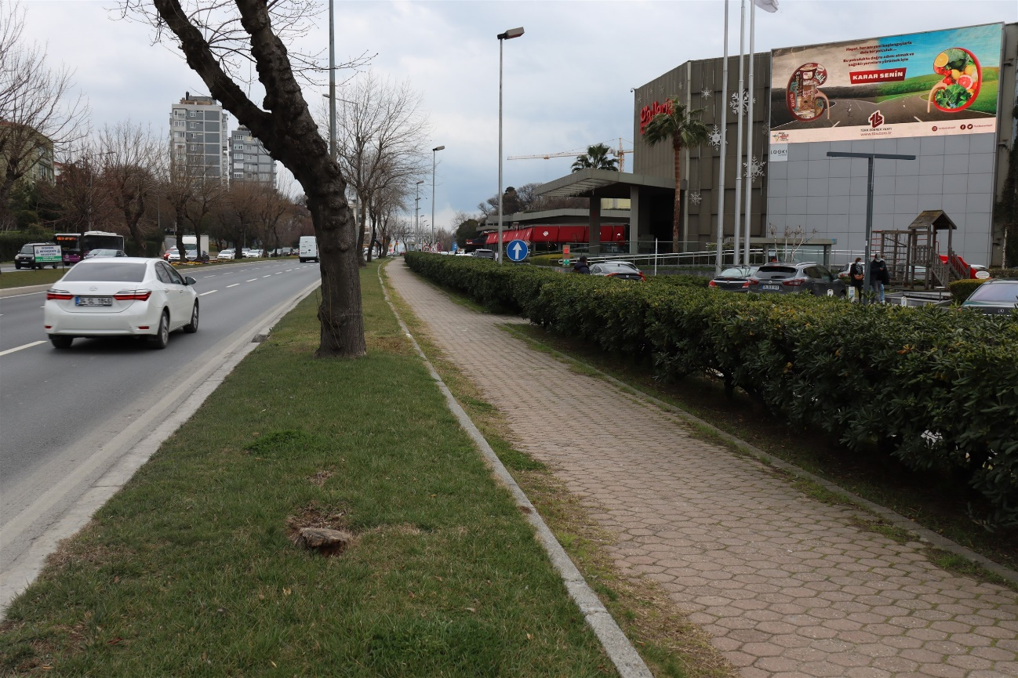
TKF – 2021 World Kidney Day
Sistem9 Medya: İstanbul Technical University/Maslak Financial District Station and Galleria Shopping Mall, giant screens

Slide 14
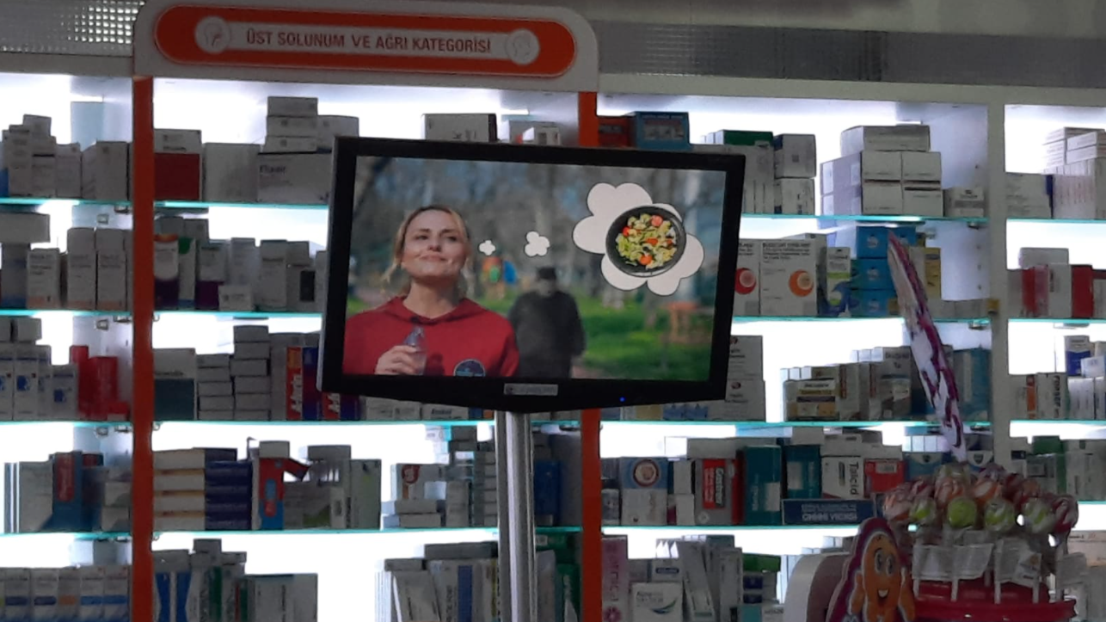
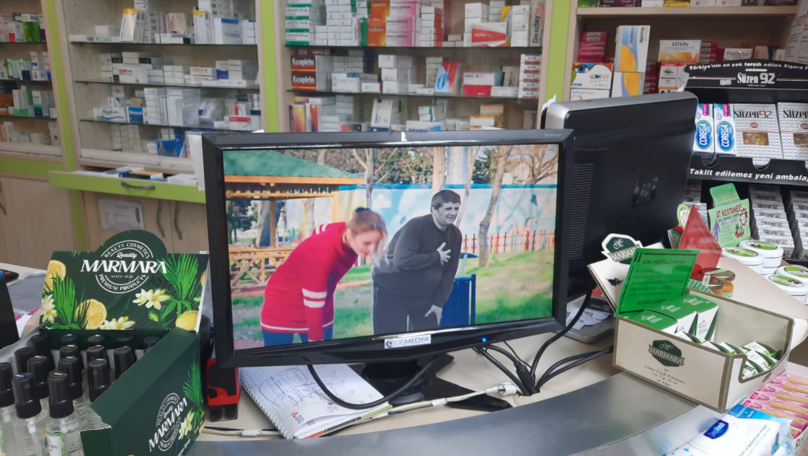
TKF – 2021 World Kidney Day
Demedya:
14 Provinces and 43 counties countrywide
347 Indoor screens in 286 pharmacies and 7 hospitals

Slide 15
TKF – 2021 World Kidney Day
Digiboard:
Bodrum Airport (Agean Region) and Ataşehir Palladium Shopping Mall, indoor screens
No photos available yet

Slide 16
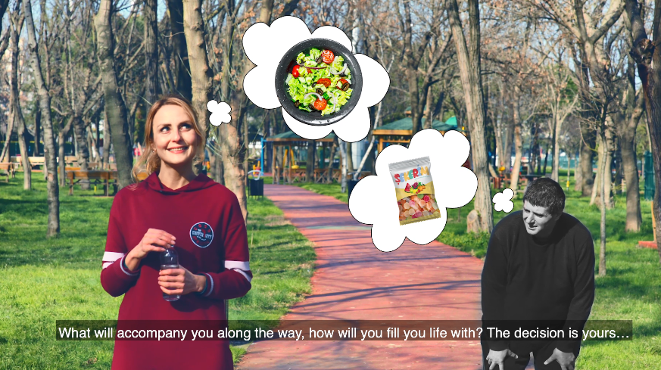
TKF – 2021 World Kidney Day
Social Media:
Our World Kidney Day video was posted on our Official Instagram, Facebook, Twitter and Youtube accounts.
Total reach number: Approximately 5 million people

Slide 17
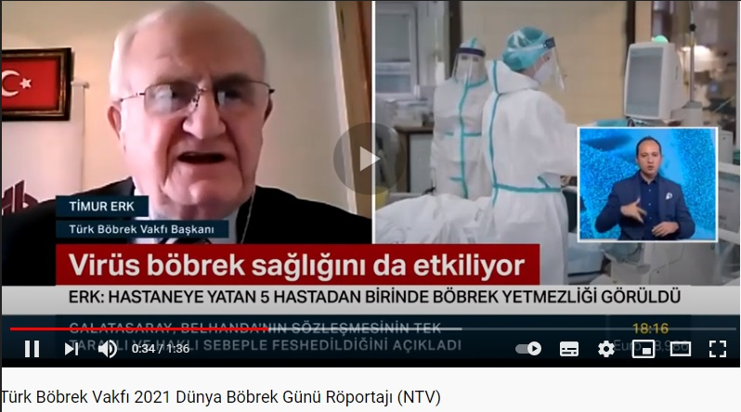
TKF – 2021 World Kidney Day
Media Coverage:
TKF President Timur Erk talked to national TV channels for World Kidney Day.
22 national and local newspapers and 72 online news websites published our WKD bulletin.

