Slide 2
What is World Kidney Day?
Worldwide campaign celebrated every year on the second Thursday of March [12 March 2015]
A joint partnership between the International Society of Nephrology (ISN) and the International Federation of Kidney Foundations (IFKF)
=> doctors and people affected by kidney disease
Goal
Increase awareness of the importance of kidneys to our health
Reduce the impact of kidney disease and associated problems worldwide

Slide 3
Why is WKD so important?
Sharp increase of chronic kidney disease (CKD) incidence worldwide
Appalling human and economic cost
Widespread ignorance about what kidneys are and how serious CKD is
=> Need to raise awareness, highlight the CKD burden and encourage general public and governments to invest in measures for better prevention and early detection

Slide 4
To whom do we address ourselves?
General public
People affected by the disease
Healthcare professionals
Health authorities, governments, policy-makers

Slide 5
General Facts about CKD
10% of the adult population suffer from CKD
Every year, millions die of complications related to CKD
Treatments like dialysis and kidney transplantation and so often are not affordable or are extremely costly and heavily weigh on public healthcare budgets

Slide 6
What do our amazing kidneys do?
Kidneys are crucial organs in the body. Your life is at risk when kidney function doesn’t work properly anymore.
They balance the volume of water in the body
They filter the blood and eliminate the waste products
They produce hormones that regulate some important body functions (blood pressure, making of red blood cells, etc)

Slide 7
What is Chronic Kidney Disease?
CKD is the presence of kidney damage, or a decreased level of kidney function for a period of 3 months or more. It usually affects both kidneys.
Below a certain level, wastes cannot be eliminated anymore from the body and may affect other organs => it is called kidney failure
Treatments to survive are:
Dialysis (BUT extremely constraining)
Transplantation (BUT organ shortage)
It is common, harmful but often treatable

Slide 8
Why is CKD such a burden?
CKD is currently not curable
CKD can cause people to need care for the rest of their lives
CKD triggers other health issues (cardiovascular diseases) leading to premature death or disability
If not detected early enough, it may progress to kidney failure and then requires dialysis or a kidney transplant to survive

Slide 9
What are the symptoms?
Early CKD has no symptoms
You can lose up to 90% of your kidney function without any sign
However:
Early detection can prevent the progression of the disease and avoid medical treatment
Early detection is highly important!

Slide 10
Are you at risk?
Most common causes are:
High blood pressure
Diabetes
Family history of kidney disease
Obesity
Age (over 50 years)
Origin (higher prevalence in people of African, Hispanic, Aboriginal and Asian origin)
Talk to your doctor if you meet one of the above criteria!

Slide 11
Can it be prevented?
8 Golden Rules
Keep fit & active
Keep regular control of your blood sugar level
Monitor your blood pressure
Eat healthily and keep your weight in check
Stay hydrated
Do not smoke
Do not take over-the-counter pills on a regular basis
Get your kidney function tested if you have one or more of the « high risk » factors

Slide 12
Our Focus in 2015
Kidney Health for All
Focus on CKD in disadvantaged populations
Not all equal in front of kidney disease incidence and access to care
Prevalence & Determinants
Ethnic origin (higher risk in some communities)
Socioeconomic factors
Environment

Slide 13
What can you do on WKD?
Become aware of your personal risk factors and how to reduce them
Spread the word to your family, friends and colleagues
Promote kidney health for all
Join the global WKD movement and celebrate with us!

Slide 14
Drink a Glass of Water and Give One Too
Mobilize your friends, colleagues and relatives.
Explain them the importance of our kidneys to our health and how to protect them.
Take a picture of yourself drinking a glass of water
Share it on social media!
#worldkidneyday
#isupportwkd
#kidneyhealthforall

Slide 15
Display your involvement
Pin your events/activities on our interactive map
Send us the pictures of your celebrations and share them on social media
Be in touch with us! [info@worldkidneyday.org]

Slide 16
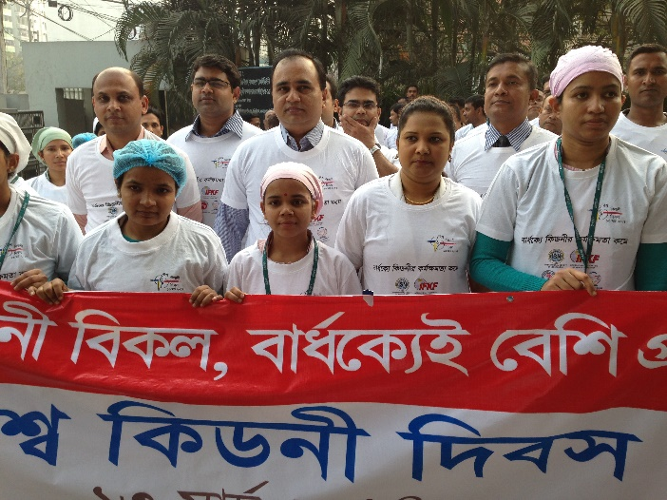
Thank You!
Together, let’s educate the general public and encourage governments to take preventive measures
Visit www.worldkidneyday.org
Follow us on
Contact us at info@worldkidneyday.org

Slide 17
Thanks to Our Partners

