Slide 1


Slide 2
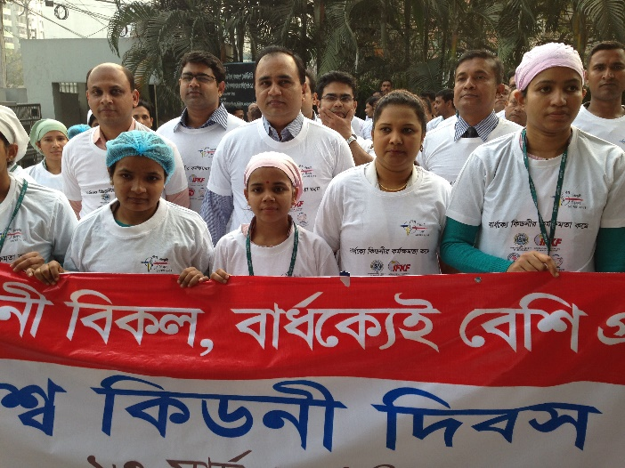




Celebrate with us!
Together, let’s educate the general public and encourage governments to take preventive measures.
Visit www.worldkidneyday.org
Follow us on
Contact us at info@worldkidneyday.org
Thanks to our partners:

